Slide 1
DIGITAL PORTFOLIO

Slide 2
DIGITAL PORTFOLIO
STUDENT NAME : SRUTHI S
REGISTER NO AND NMID : 2422K1606 AND asbru4q2422k1606
DEPARTMENT : COMPUTER SCIENCE
COLLEGE : KSG COLLEGE OF ARTS AND SCIENCE
UNIVERSITY : BHARATHIAR UNIVERSITY

Slide 3
STUDENT PORTFOLIO
USING FRONT-END DEVELOPMENT
Notes:
STUDENT PORTFOLIO

Slide 4
AGENDA
Problem Statement Project Overview End Users Tools and Technologies Portfolio design and Layout Features and Functionality Results and Screenshots Conclusion GitHub Link

Slide 5
PROBLEM STATEMENT :
In today’s competitive digital world, individuals need an effective way to showcase their skills, projects, and experience online. Traditional resumes and paper-based portfolios are not interactive or visually engaging. There is a need for a personalized, responsive digital portfolio that highlights a person’s technical and creative capabilities using modern front-end development technologies like HTML, CSS, and JavaScript.

Slide 6
PROJECT OVERVIEW :
This project focuses on developing a digital portfolio website using front-end technologies like *HTML, CSS, and JavaScript*. The portfolio serves as an online representation of an individual’s professional profile, allowing users to showcase their skills, achievements, and projects in a well-structured and visually appealing manner

Slide 7
CONTENT INCLUDED IN PORTFOLIO :
Home / About Me : Introduction, background, and personal profile. Projects: Description of completed or ongoing projects with images or links.
Skills : List of technical and soft skills categorized appropriately Contact : Contact form or contact details for communication.

Slide 8
MAIN IDEA :
To create a responsive and interactive platform that highlights an individual’s *personal achievements*, *technical capabilities*, and *professional work*, helping them stand out to employers, clients, or academic evaluators.

Slide 9
END USERS
Students : To showcase academic projects, coursework, and resumes. Job Seekers : To present their portfolio to recruiters as part of job applications. Freelancers :
To display their work samples and attract potential clients. Professionals : To highlight career experience, skills, and achievements for networking or advancement

Slide 10
TOOLS AND TECHNIQUES :
HTML→ Provides the structure of the webpage (sections like About, Projects, Contact, etc.). CSS → Handles styling, including colours, fonts, layout, and responsiveness (mobile and desktop view). JavaScript → Adds interactivity such as: Navigation menus Animations Form validation Code Editors → Tools like VS Code or Code Pen for writing code. Hosting Platform → Example: GitHub Pages to publish the portfolio online

Slide 11
PORTFOLIO DESIGNS AND LAYOUT :
Home / About Me :
Introduction about me, background, and a short bio. Projects : Portfolio website Task Management app Skills : List of technical and soft skills (ie., programming languages c,c++,python, Hardware Networking, Mob App development). Contact: A contact form and email link

Slide 12
FEATURES AND FUNCTIONALITY :
Navigation Bar with Smooth Scrolling : Fixed top navigation bar easy section access. Smooth scrolling using JavaScript or CSS for better user experience.
Project Showcase with Images/Details : Visually display projects using thumbnails or cards. Each project includes title, tech stack, and a short description. Interactive Elements : Hover effects on buttons or images. -Animations for transitions or element loading.

Slide 13
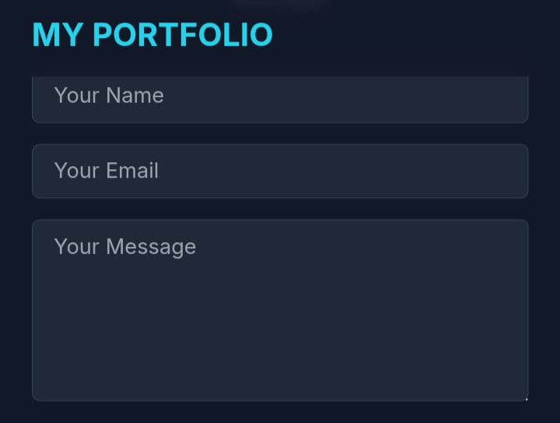
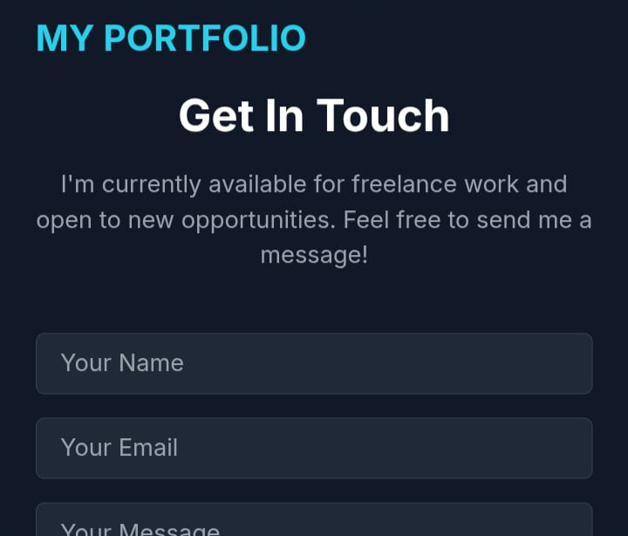
RESULTS AND SCREENSHOTS :

Slide 14
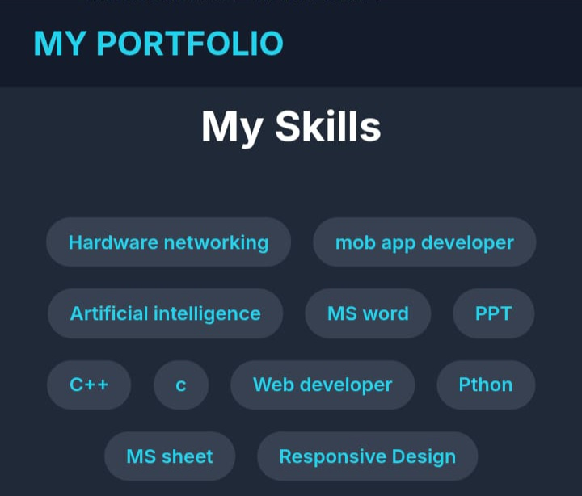
SCREENSHOTS :

Slide 15
Final Summary :
The project successfully integrates HTML, CSS, and JavaScript to build a fully responsive portfolio website. It demonstrates both technical and design capabilities.

Slide 16
BENEFITS FOR SOCIETY :
It empowers students, job seekers, and professionals to present their profiles effectively, improving visibility and increasing opportunities in academics and careers.

Slide 17
Conclusion
This digital portfolio project highlights key achievements, skills, and personal/professional growth in a structured and interactive way. It offers a user-friendly experience with smooth navigation, project showcases, and responsive design.

